Slide 1
ICT in Transport
Introduction to information and communication flow system

Slide 2
Defining ICT
A family of electronic technologies and services used to process, store and disseminate information, facilitating the performance of information-related human activities, provided by, and serving the institutional and business sectors as well as the public-at-large.

Slide 3
Types of ICTs

Slide 4
What are not ICTs devices?

Slide 5
Barriers to ICT implementation

Slide 6
Functioning of ICTs

Slide 7
Appearance and use of information and communication technologies

Slide 8
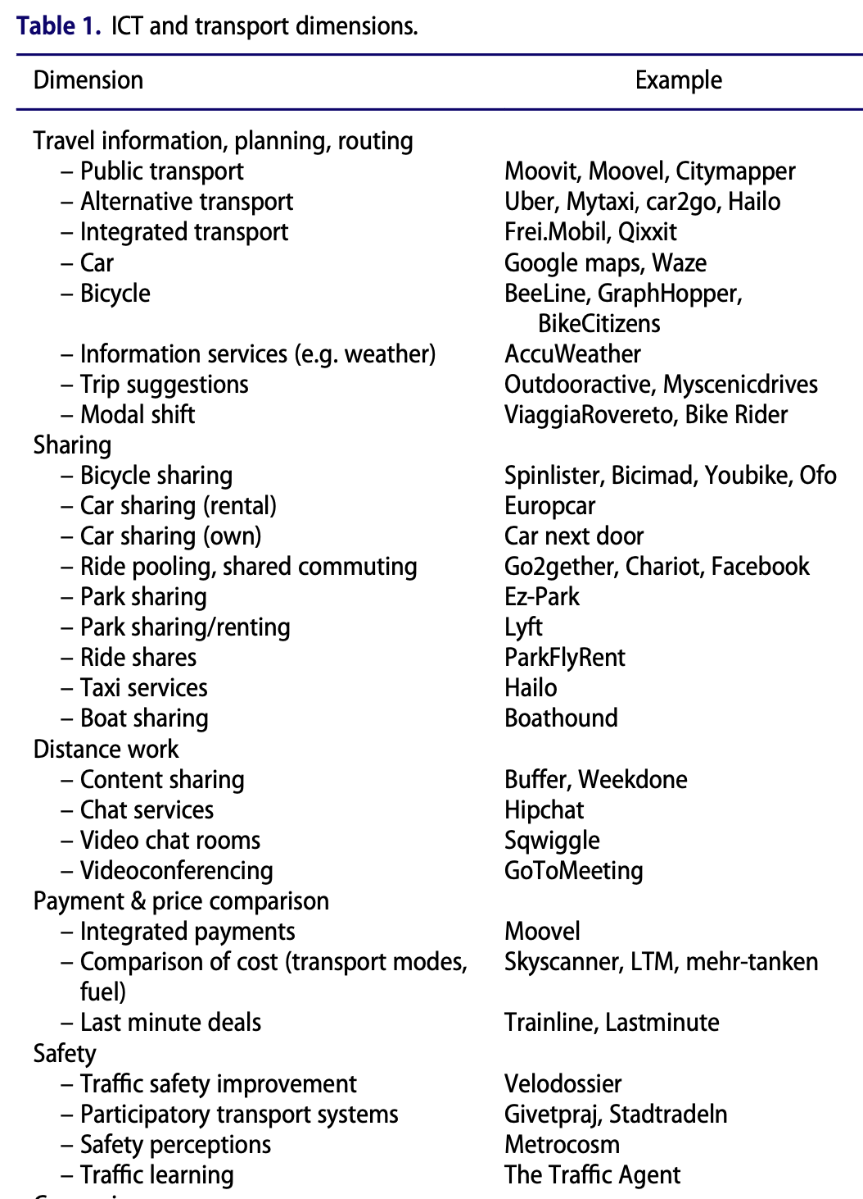
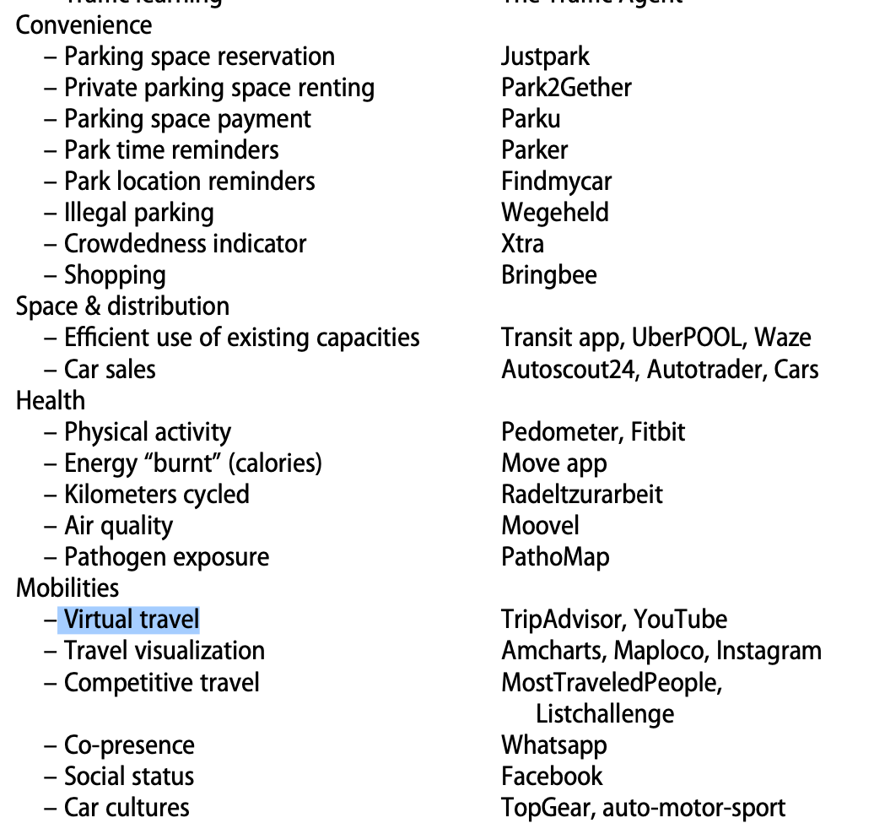

Slide 9
ICT and sustainable transportation
Information and communication technology plays a vital role in the sector of transportation. The ICT market continually launches new applications that support traffic congestion control, transport logistics and transport infrastructure management. In addition to all these ICT has also invaded the new era of transporting information rather than people. The ICT applications have the potential to increase the efficiency of transport networks and decrease the negative externalities, e.g. decrease the congestion and increase the quality of transport networks. However their actual impacts on transport sector and the sustainable development are still unknown. In the transport sector, the deployment of ICT in the developed cities like Stockholm has been the era of developing sensing capabilities both of vehicles and traffic monitoring systems to perceive anomalies, and hazards in the environment, and to improve the fluency of traffic for less costs and cleaner environment. The widespread adoption and development of ICT that promote sustainable transport behaviour are perquisite in terms of sustainability to be realized (Weisers, 2008). Therefore it is essential to recognize the dynamics of ICT in the field of transportation.

Slide 10
Working of RFID

Slide 11
How can we reduce traffic congestion?

Slide 12
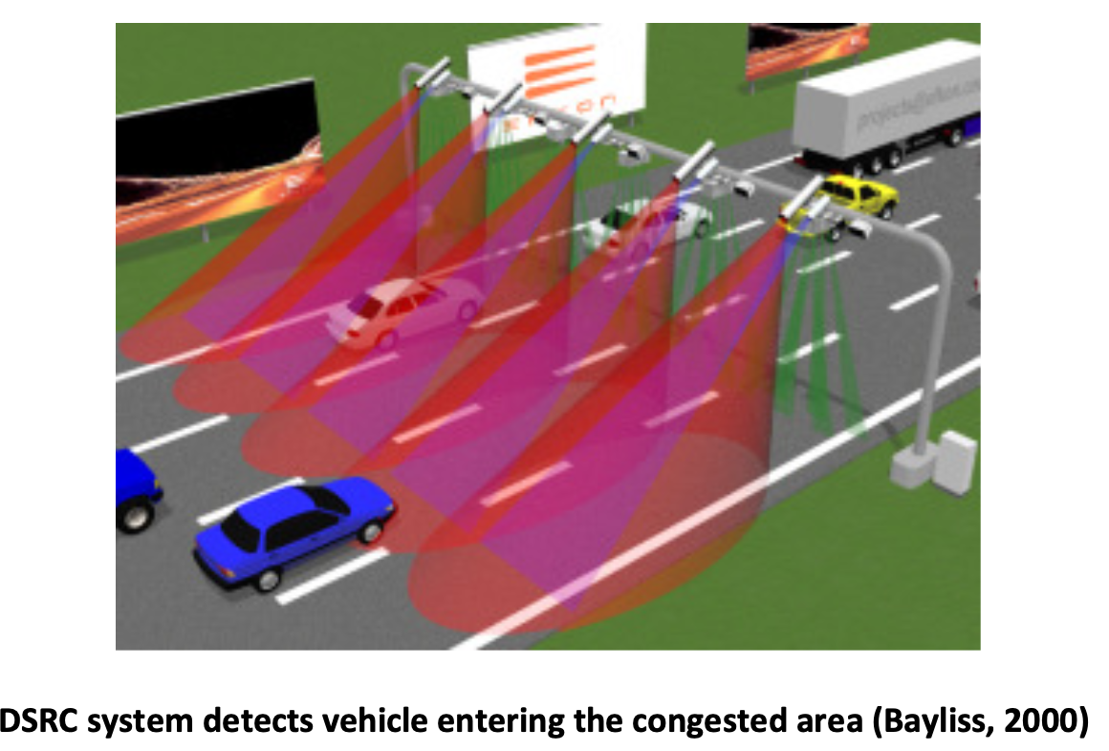

Slide 13
Automatic license plate recognition (ALPR) Technology
ALPR technology is used in most of the electronic congestion pricing systems; this system has been so much in favour of controlling the congestion in a documented way. This technology of ICT is very often used as a backup for either the DSRC systems or the VPS for enforcement. The ALPR system is based on taking the images of the number plates of the vehicle crossing the area, and then processing the image with the character recognition software to identify the vehicle and its owner. In most of the case in the recent days, the electronic pricing system has a front and a rear camera to take pictures of both sides of the car, so that the identification rate can be improved.
The components that the ALPR system merely requires are the pole or gantry mounted cameras, and an illumination device, provided the entire setup is road side or street based. Depending on the system design there might be a need for the two cameras (Front and the Rear), and classification devices.

Slide 14
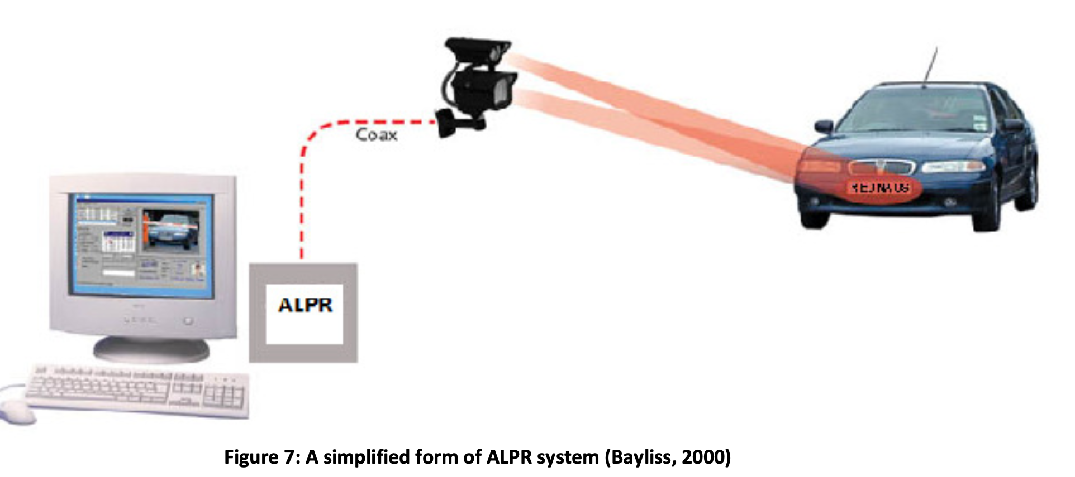

Slide 15
In addition to these basic components of ALPR, there should also be some necessary form of system controller that requires a constant power supply and communication connections through a purpose designed control unit for each camera locations. The communication connection should have a promising network set up with a dedicated fibre-optic connection, and the power supply should be uninterruptable. This system is not only used for enforcement backup, but some cities like Stockholm are using only the ALPR systems for charging. When there is a complete absence of the in vehicle unit with the tags or transponders, it simply takes the picture of the number plate and the picture is matched with a highly reliable character recognition software to identify the owner of the vehicle, and a monthly invoice is sent (Stockholm Traffic Administration, 2009). The picture below gives a clear idea, on how the matching is done to identify the owner.

Slide 16
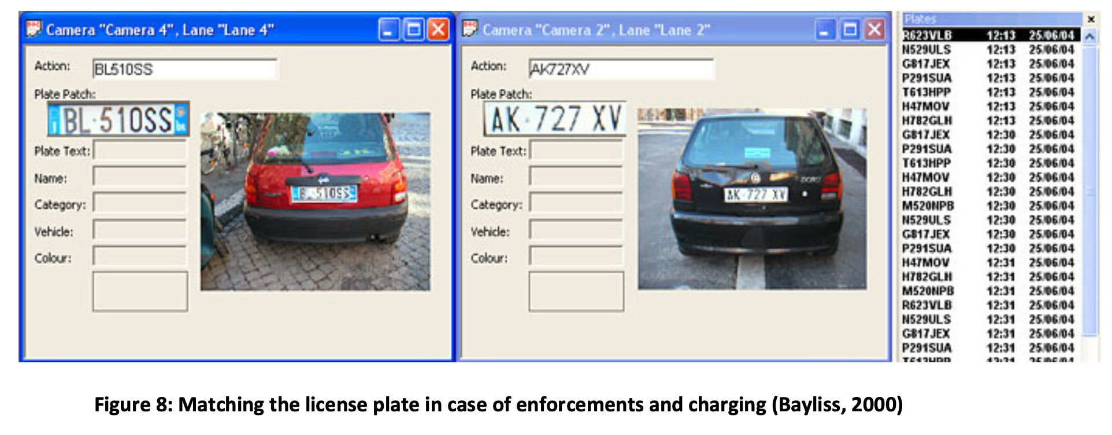

Slide 17
What do you perceive is the main problem with the ALPR technology?

Slide 18
In what ways the real time information sharing solutions help in reducing the traffic congestion?

Slide 19
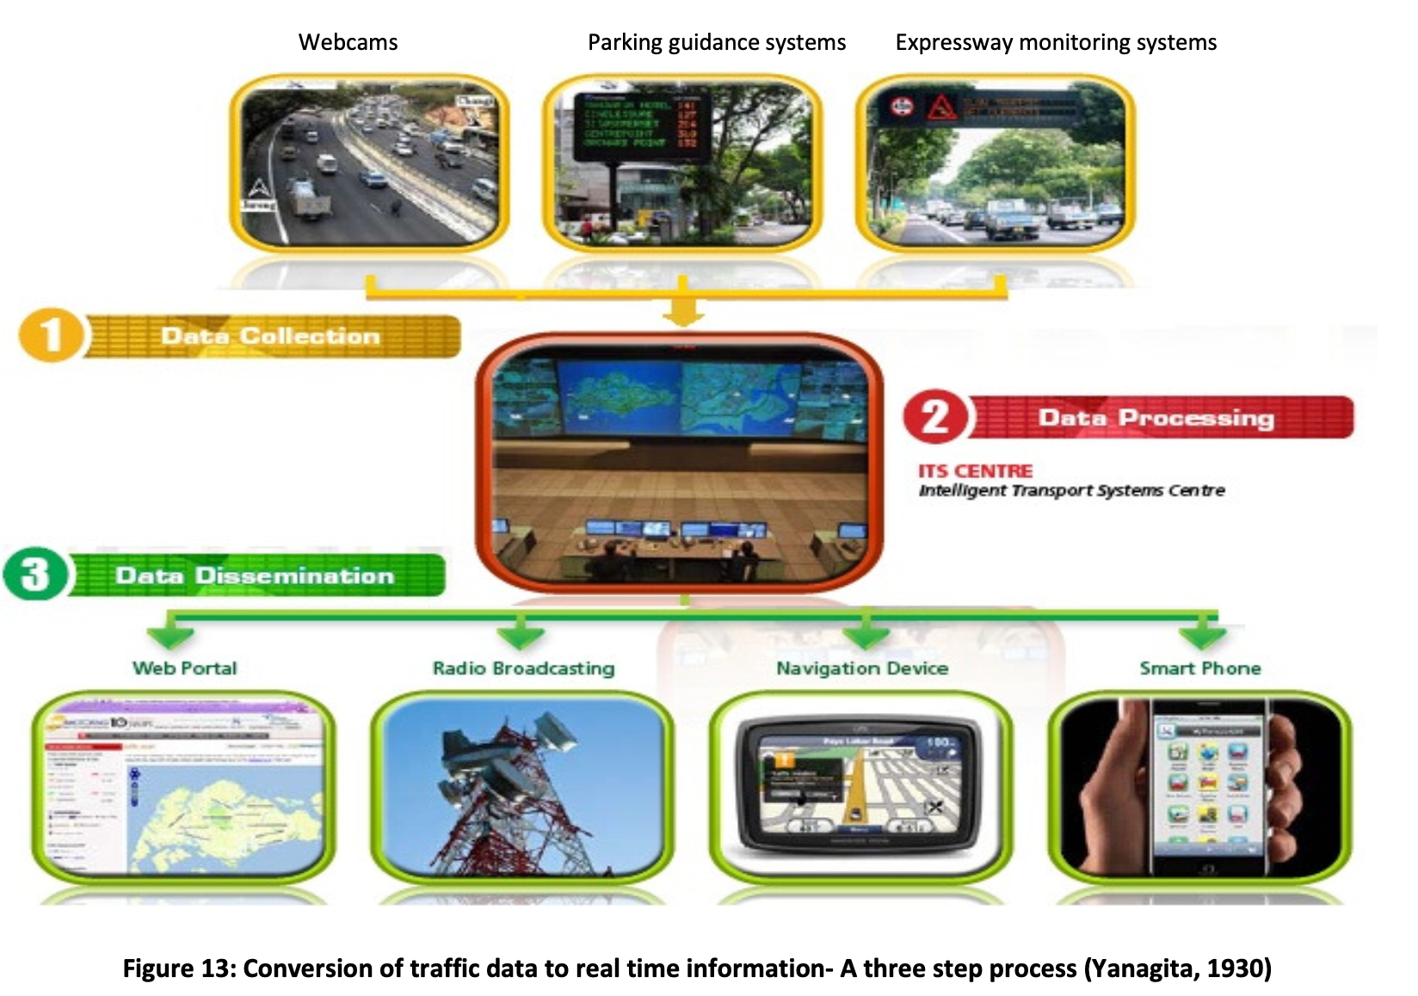

Slide 20
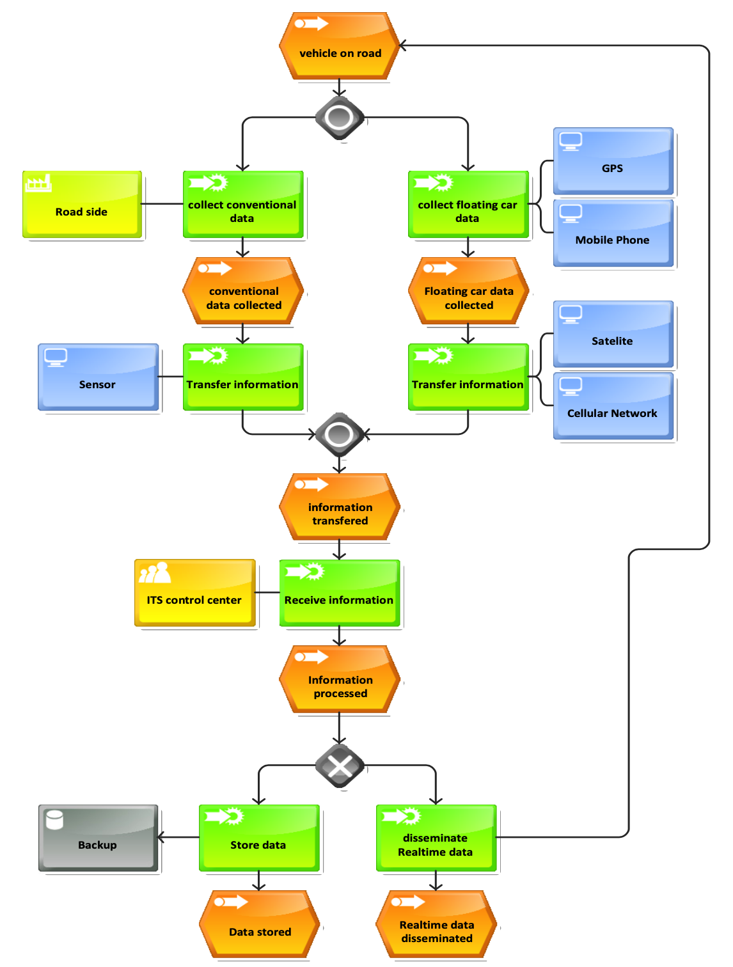
Real time information sharing process

Slide 21
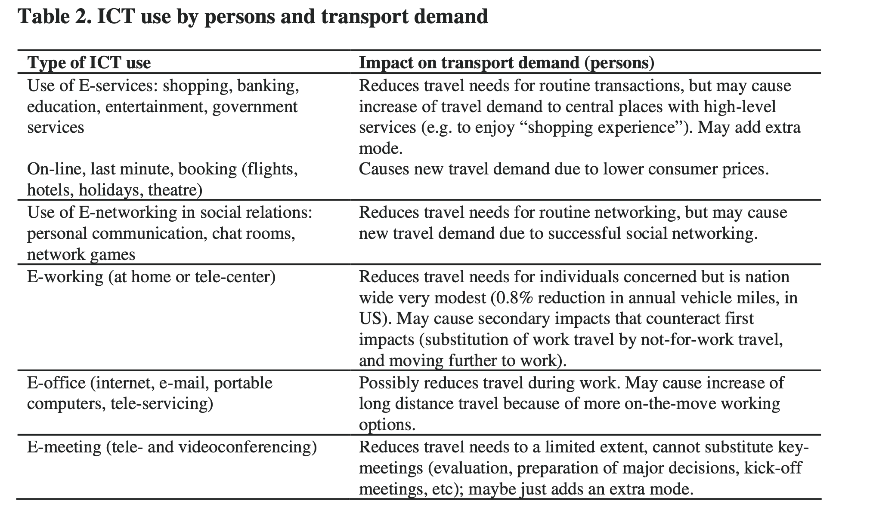

Slide 22
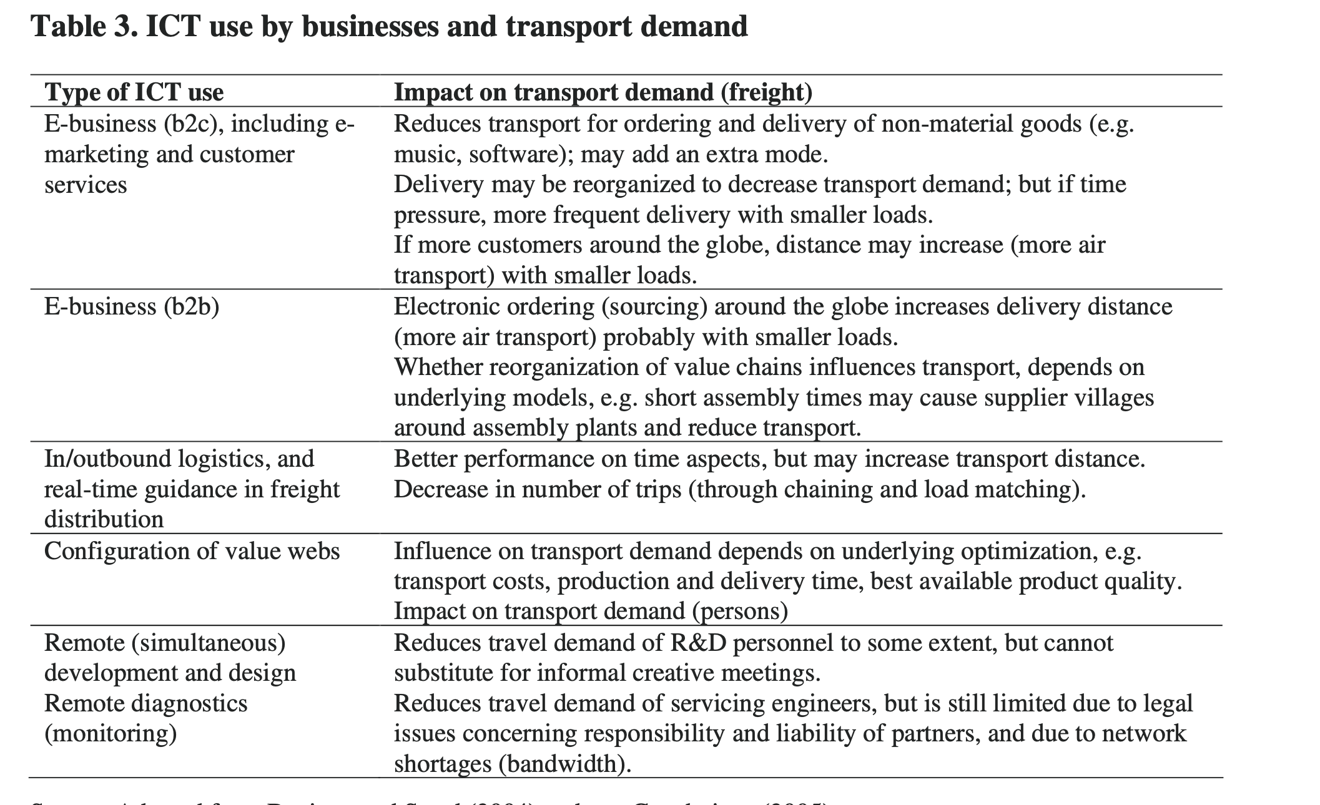

Slide 23
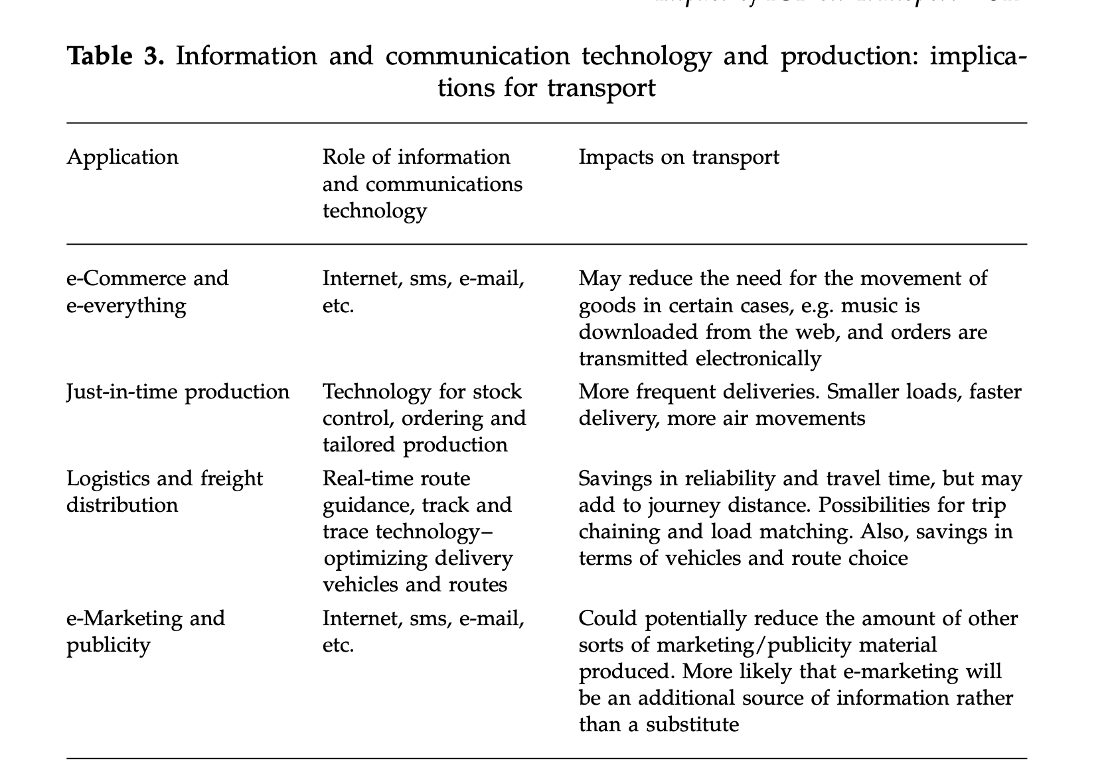

Slide 24
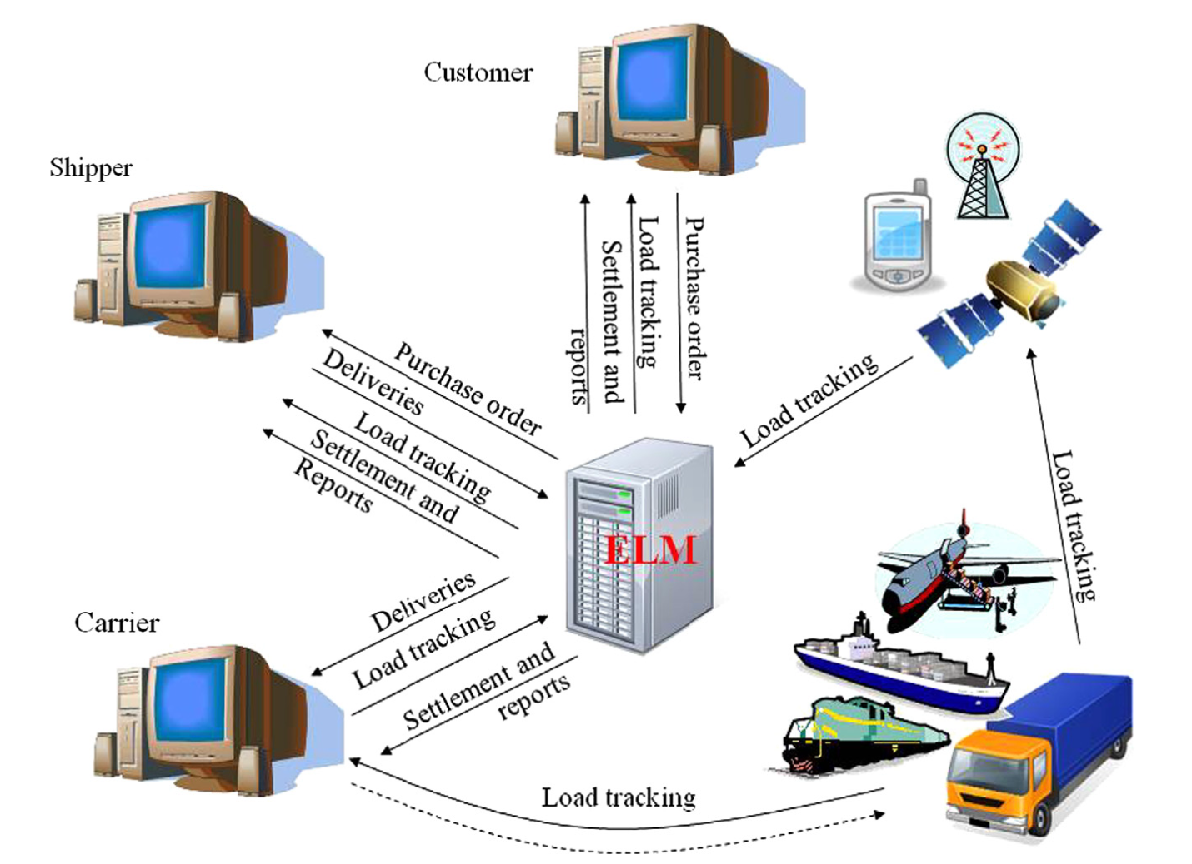

Slide 25
